Slide 1
Microsoft Fabric Lakehouse
Hell or glory
Tom Martens @ Havens Consulting Live Stream
2024-02-02

Slide 2
Inside the box
Who I am
Microsoft Fabric / Lakehouse (what’s that)
It’s not only tech, it’s also about people

Slide 3

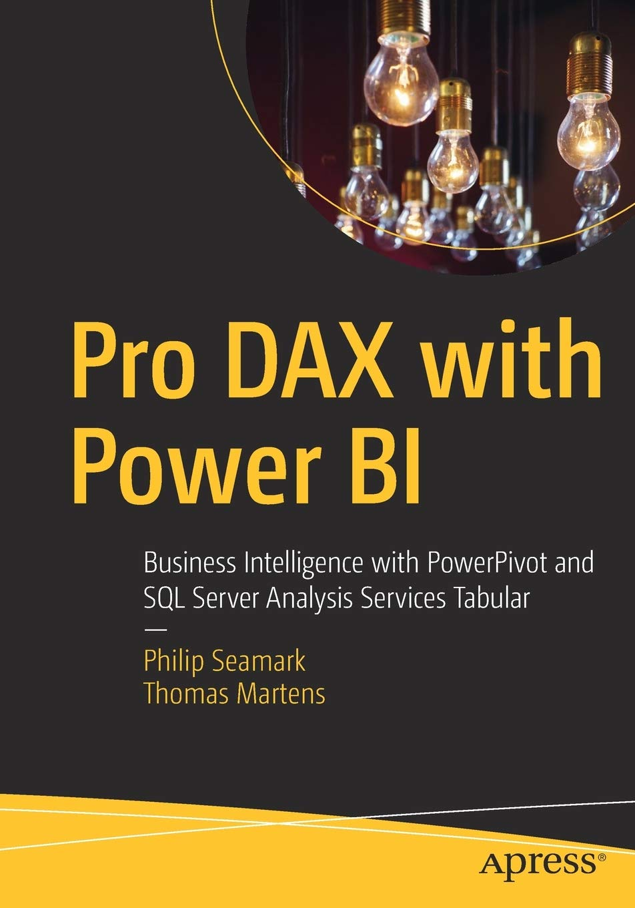
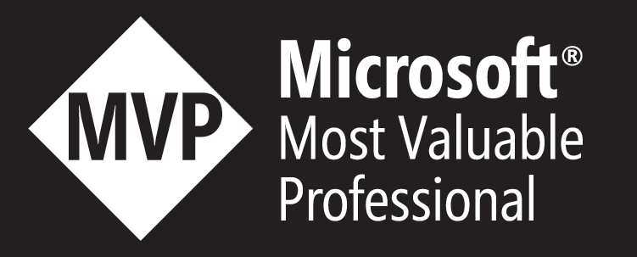
Tom Martens
25+ years of experience designing analytical solutions using the MSFT data platform
Solution Architect @ Munich Re
/tommartens68
@tommartens68

Slide 4

Microsoft Fabric is entering the stage

Slide 5





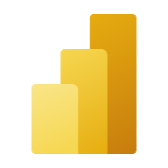


Microsoft Fabric
Unified analytics platform
Lake centric and open
Empower every Office user
Pervasive security and governance
Data
Factory
Synapse Data
Engineering
Synapse Data Warehouse
Synapse Data Science
Synapse Real Time Analytics
Power BI
Data Activator (coming soon)
OneLake

Slide 6

The (awesomeness) of Fabric (probably I’m biased)
All the compute engines store their data automatically in OneLake
The data is stored in a single common format
Delta – Parquet, an open standards format, is the storage format for all tabular data in Analytics vNext
Once data is stored in the lake, it is directly accessible by all the engines without needing any import/export
All the compute engines have been fully optimized to work with Delta Parquet as their native format
Shared universal security model is enforced across all the engines
Synapse Data
Science
Synapse Data Warehousing
Data
Factory
Synapse Data
Engineering
Synapse Real Time Analytics
Power BI
Data Activator
Serverless
Compute
Spark
T-SQL
KQL
Analysis Services
OneLake
Customers 360
Finance
Service Telemetry
Business KPIs
Delta – Parquet Format
Delta – Parquet Format
Delta – Parquet Format
Delta – Parquet Format

Slide 7
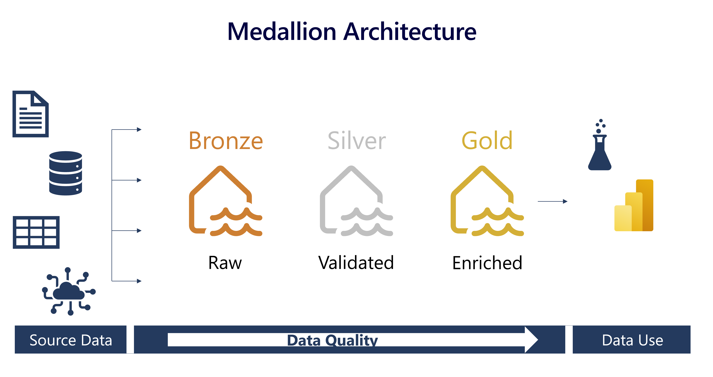
Describe medallion architecture
Data lakehouses in Fabric are built on the Delta Lake format, which natively supports ACID (Atomicity, Consistency, Isolation, Durability) transactions.
Notes:
Data lakehouses in Fabric are built on the Delta Lake format, which natively supports ACID (Atomicity, Consistency, Isolation, Durability) transactions. Within this framework, the medallion architecture is a recommended data design pattern used to organize data in a lakehouse logically. It aims to improve data quality as it moves through different layers. The architecture typically has three layers – bronze (raw), silver (validated), and gold (enriched), each representing higher data quality levels. Some people also call it a "multi-hop" architecture, meaning that data can move between layers as needed.
This architecture ensures that data is reliable and consistent as it goes through various checks and changes. It also guarantees that the data is safely stored in a way that makes it easier and faster to analyze.
The medallion architecture complements other data organization methods, rather than replacing them. You can think of the medallion architecture as the framework for data cleaning, rather than a data architecture or model. It ensures compatibility and flexibility for businesses to adopt its benefits alongside existing data models, allowing you to customize data solutions and preserve expertise while remaining adaptable in the ever-changing data landscape.

Slide 8



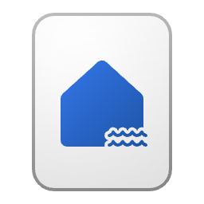
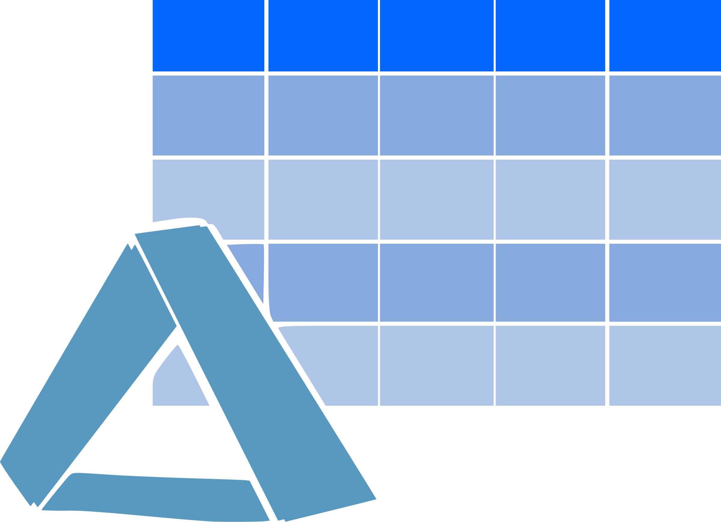
Understand the medallion architecture format
Bronze Layer
Get all the data
Silver Layer
Creating structure
Gold Layer
Harvesting insights
Any format

Slide 9

Wait a minute …

Slide 10
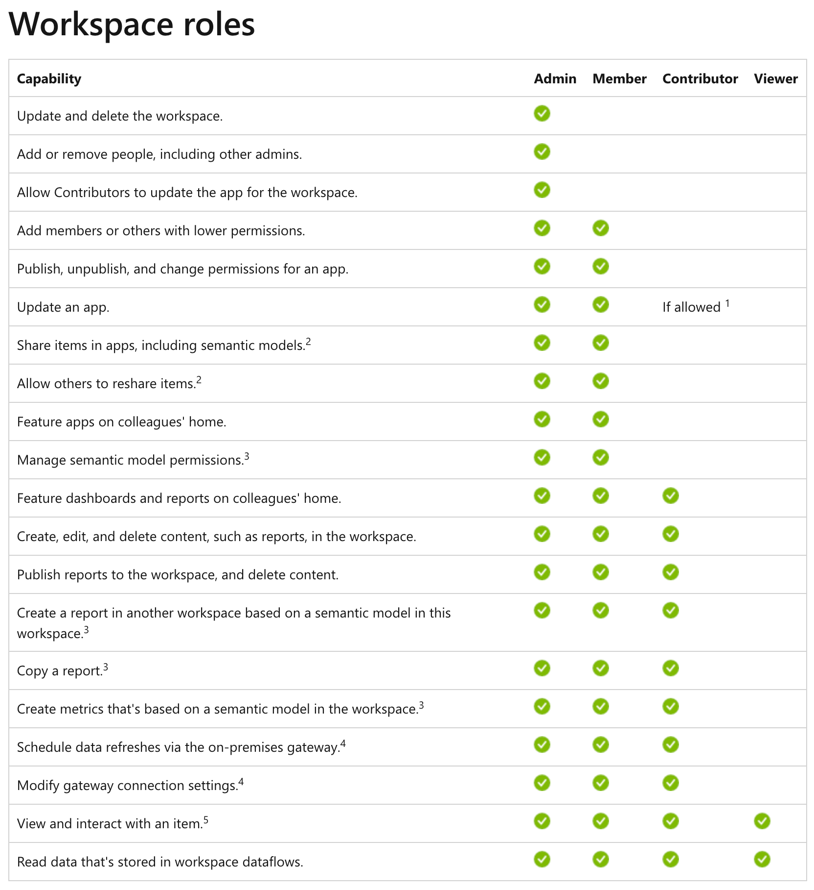

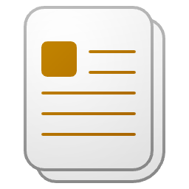




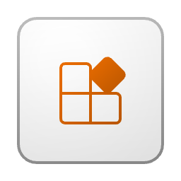


How we work today – our beloved workspace

Slide 11
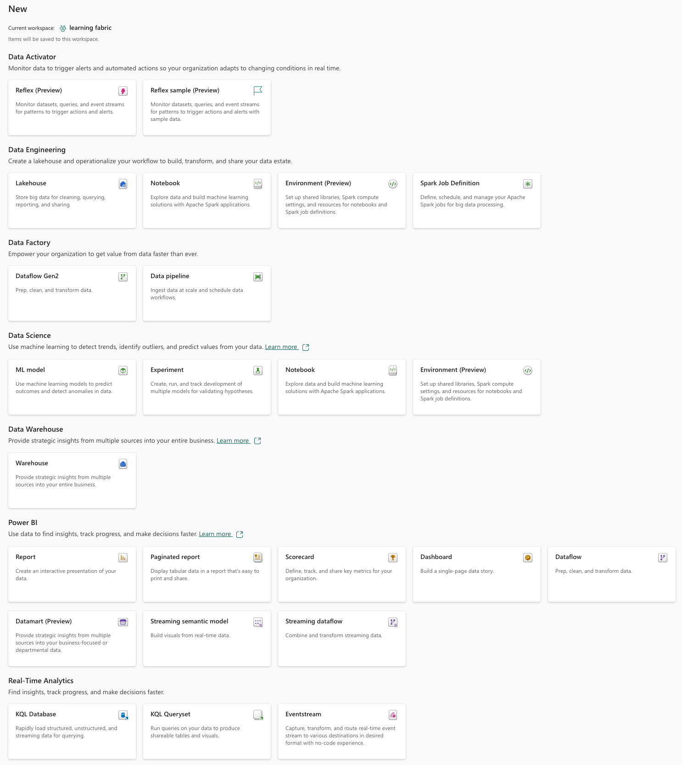
The Power BI “world” has transformed into a Microsoft Fabric cosmos (basically, this is good)
The amazing things we can create now and that will be stored inside a workspace (so much more than a simple container)!

Slide 12
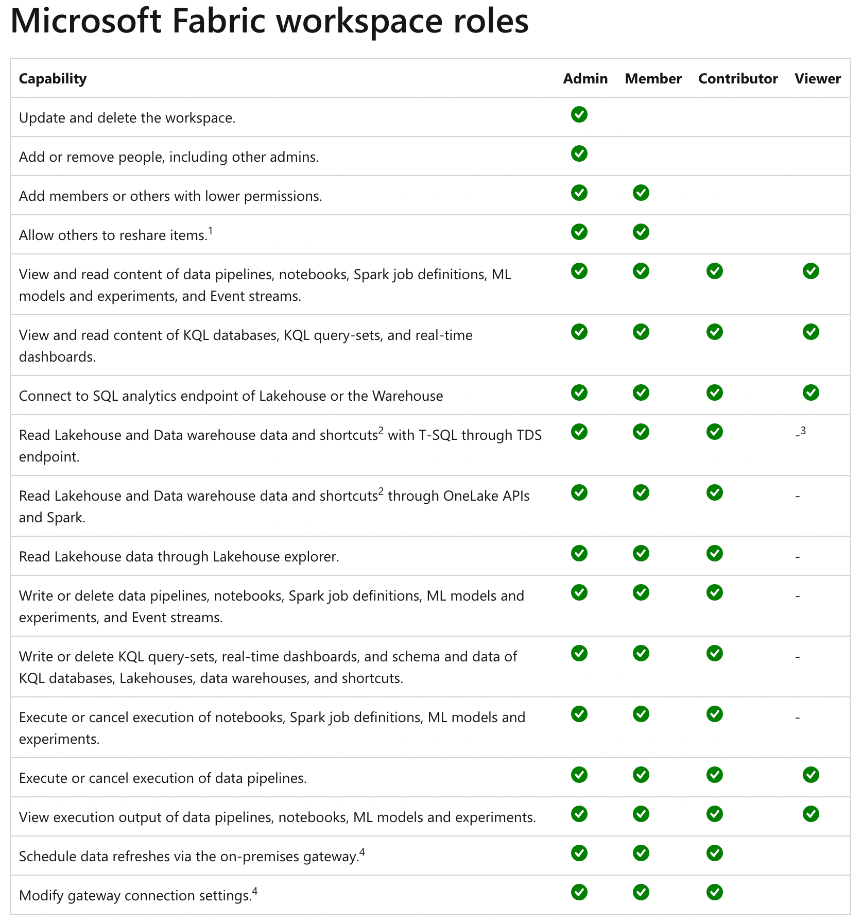
The “simple” Power BI workspace roles are not simple anymore
https://learn.microsoft.com/en-us/fabric/get-started/roles-workspaces

Slide 13

It’s not only technology it’s also about people (risk mitigation by organizing our workloads)

Slide 14




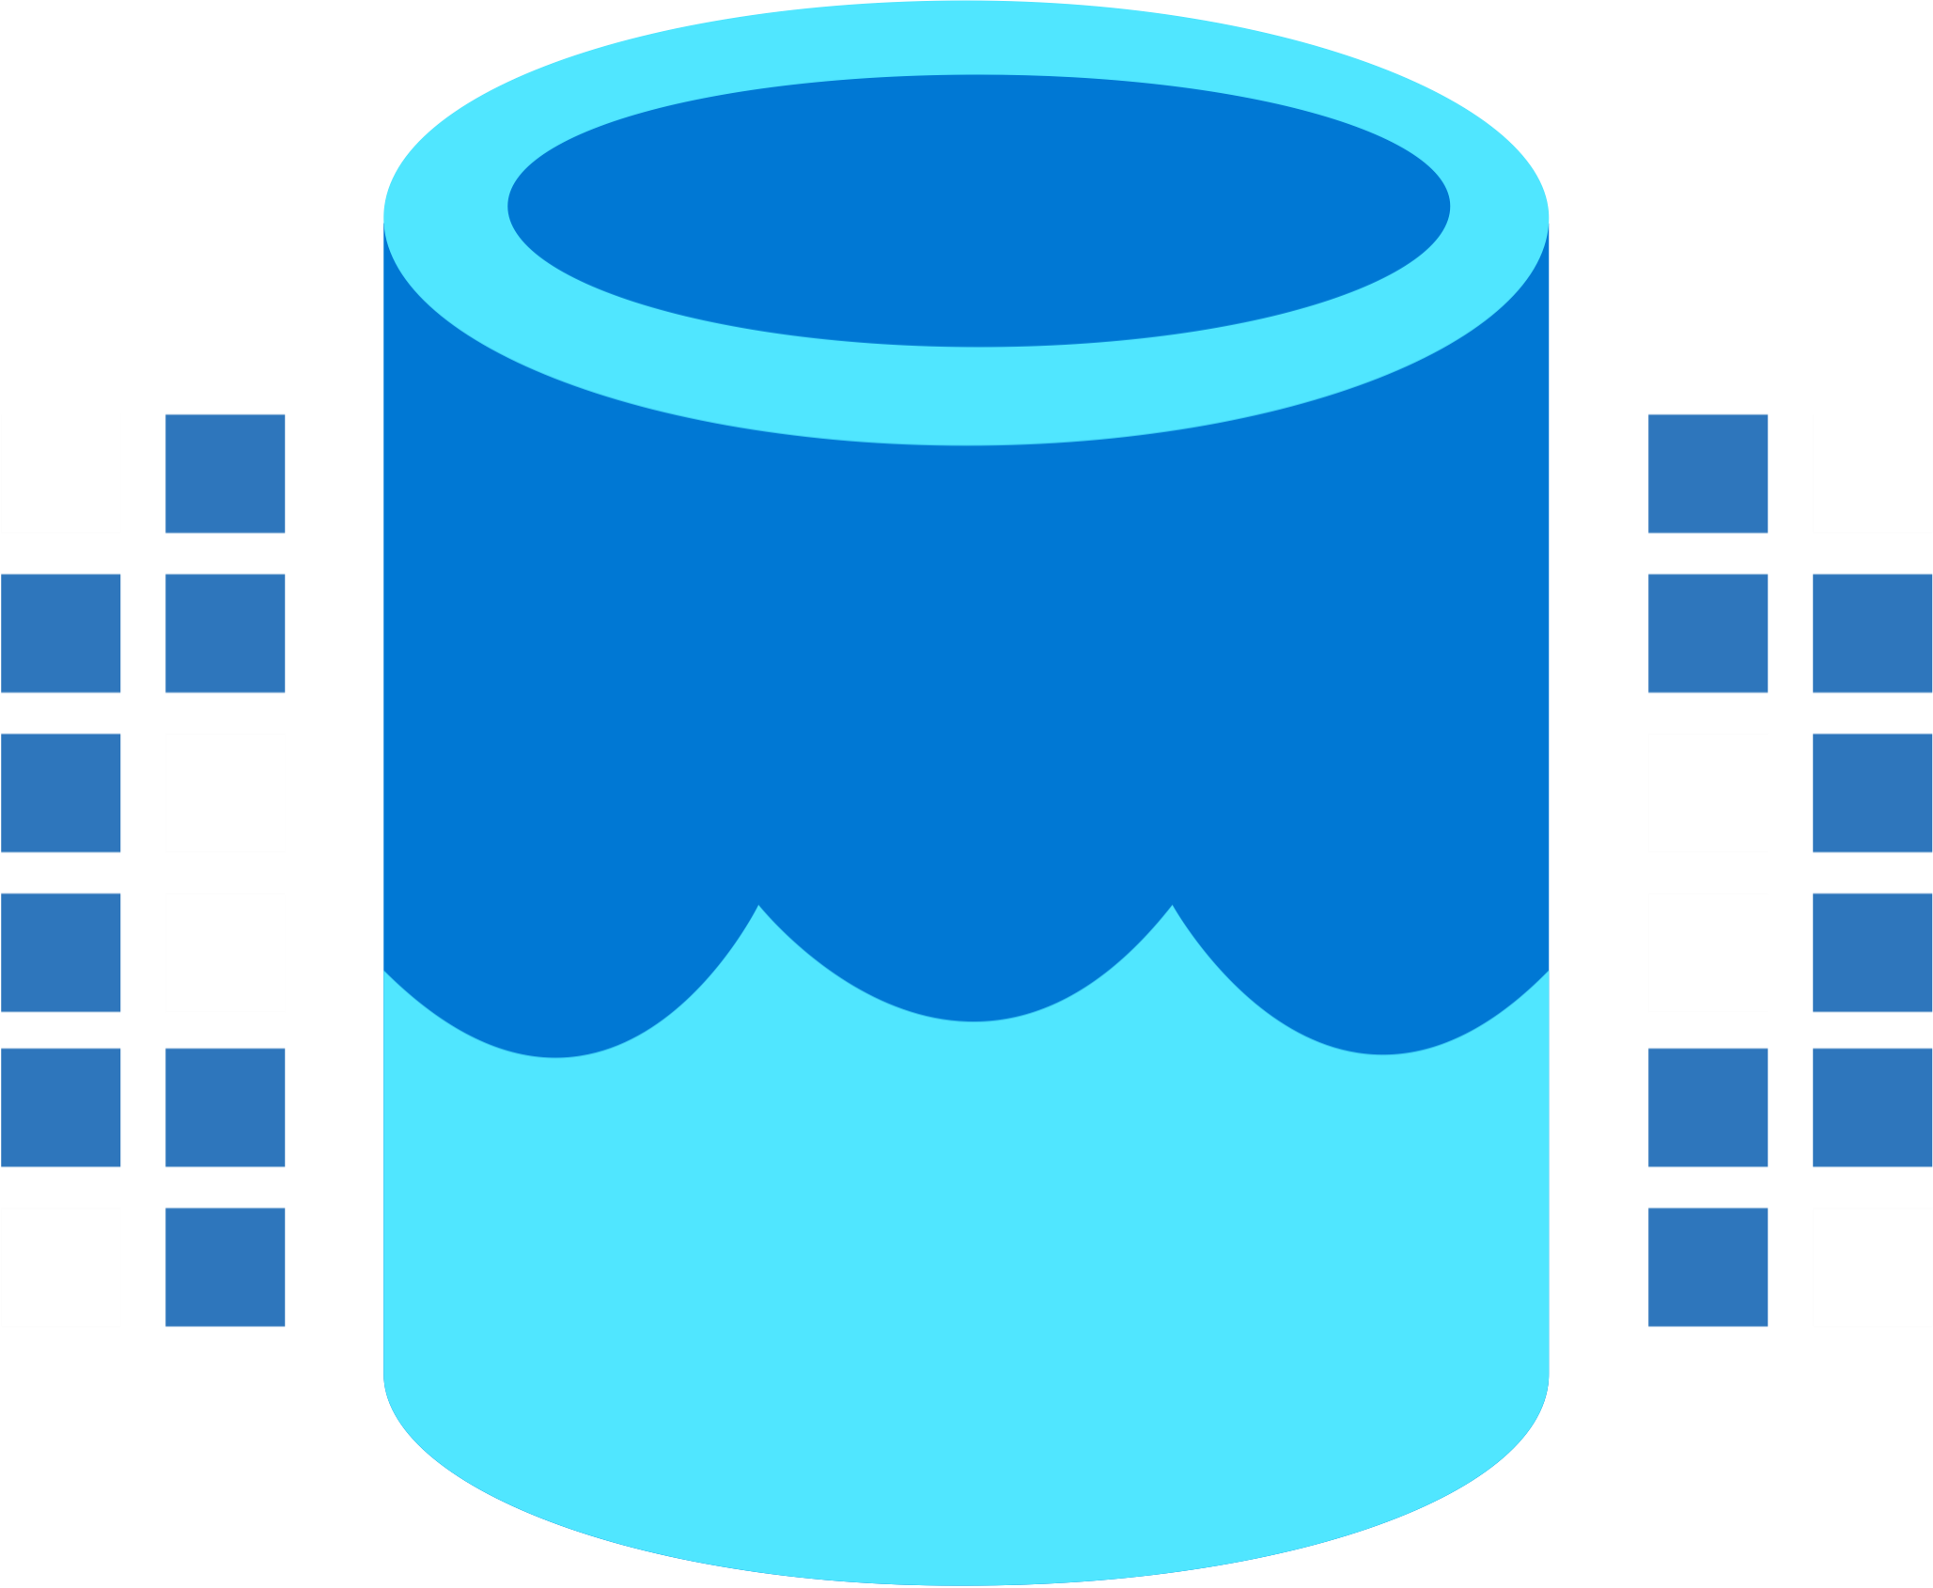

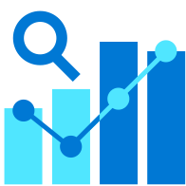

Our team is growing
Data Integration
Data Lake
Spark Engines
Data Lakehouse/
Warehouse
Real Time Analytics
Data
Science
Business
Intelligence
Governance
End-to-end analytics data fabric - From the data lake to the business user

Slide 15
Our team is growing
Data Integration
Data Lake
Spark Engines
Data Lakehouse/
Warehouse
Real Time Analytics
Data
Science
Business
Intelligence
Governance
End-to-end analytics data fabric - From the data lake to the business user

Slide 16
Our team is growing
Data Integration
Data Lake
Spark Engines
Data Lakehouse/
Warehouse
Real Time Analytics
Data
Science
Business
Intelligence
Governance
End-to-end analytics data fabric - From the data lake to the business user

Slide 17

The landscape of a Microsoft Fabric solution! (My thinking)
The Lakehouse – Medallion architecture
We can create a Lakehouse leveraging the Medallion Architecture
Placing each metal in a dedicated workspace
Bronze (Landing Zone)
Silver
Gold (Business level aggregates)
Data Integration

Slide 18
The landscape of a Microsoft Fabric solution! (My thinking)
The Lakehouse – Medallion architecture
We can create a Lakehouse leveraging the Medallion Architecture
Placing each metal in a dedicated workspace
Bronze (Landing Zone)
Silver
Gold (Business level aggregates)
Data Integration
Different stages of the Medallion architecture may be placed on different capacities

Slide 19
The landscape of a Microsoft Fabric solution! (My thinking)
The Lakehouse – Medallion architecture
Using dedicated compute power (a capacity) for Data Science workloads because these workloads might run less or more frequently, require extra computing power, or …
Bronze (Landing Zone)
Silver
Gold (Business level aggregates)
Data
Science

Slide 20

Our team is growing
The Lakehouse – Medallion architecture
Using dedicated workspaces for different workloads helps us to keep our items separate between different workloads and, for this reason, safe from accidental harm.
Next to that, it provides many more advantages, e.g. spreading workloads across capacities
Bronze (Landing Zone)
Silver
Gold (Business level aggregates)
Data
Science

Slide 21
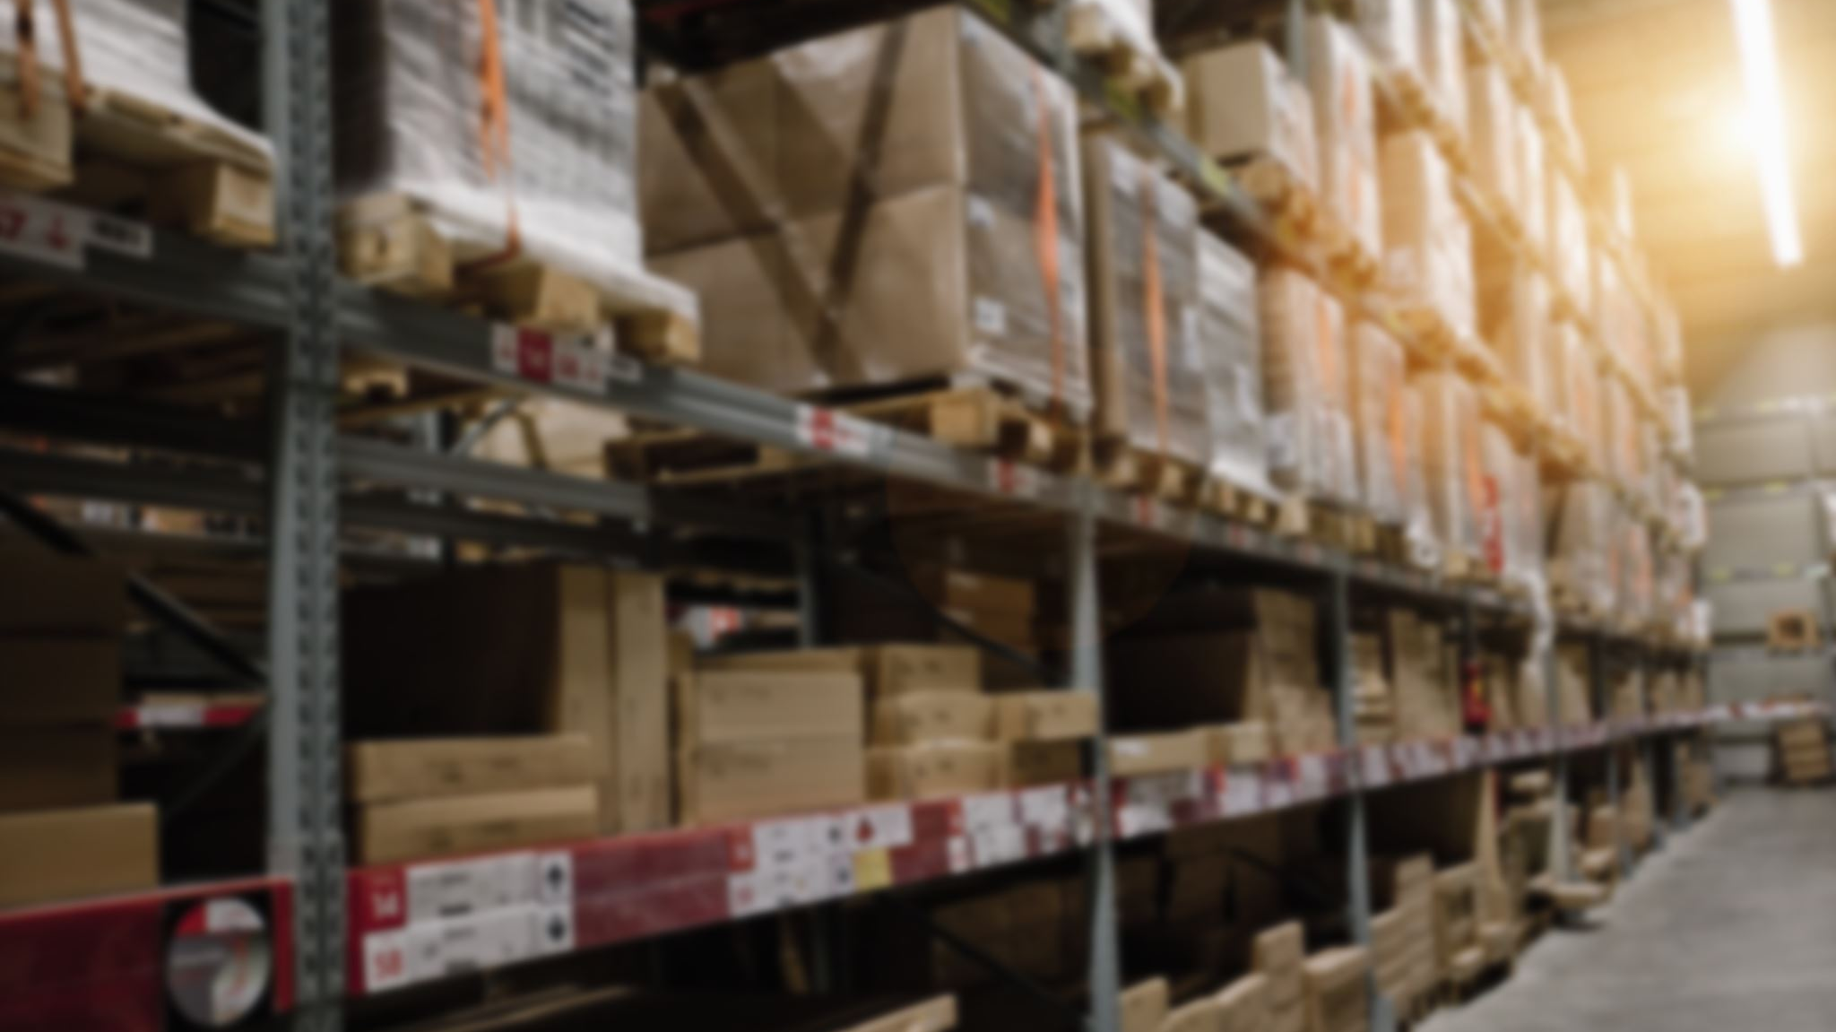
Use SQL security features with the data warehouse item

Slide 22
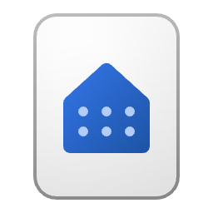
Rstrict Access to objects using T-SQL on the lakehouse
The data owning workspace
Use SQL commands in the data owning workspace to restrict access like
DENY SELECT ON OBJECT::dbo.DimDate TO [mvp@minceddata.com];
The data modeling workspace
Business
Intelligence
Synapse Data Engineering

Slide 23
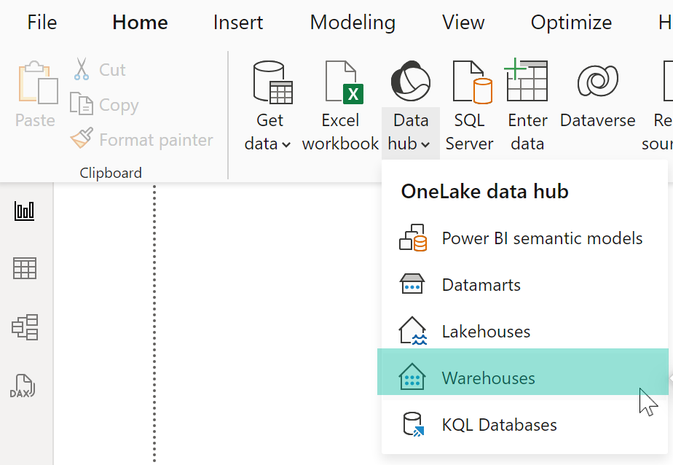
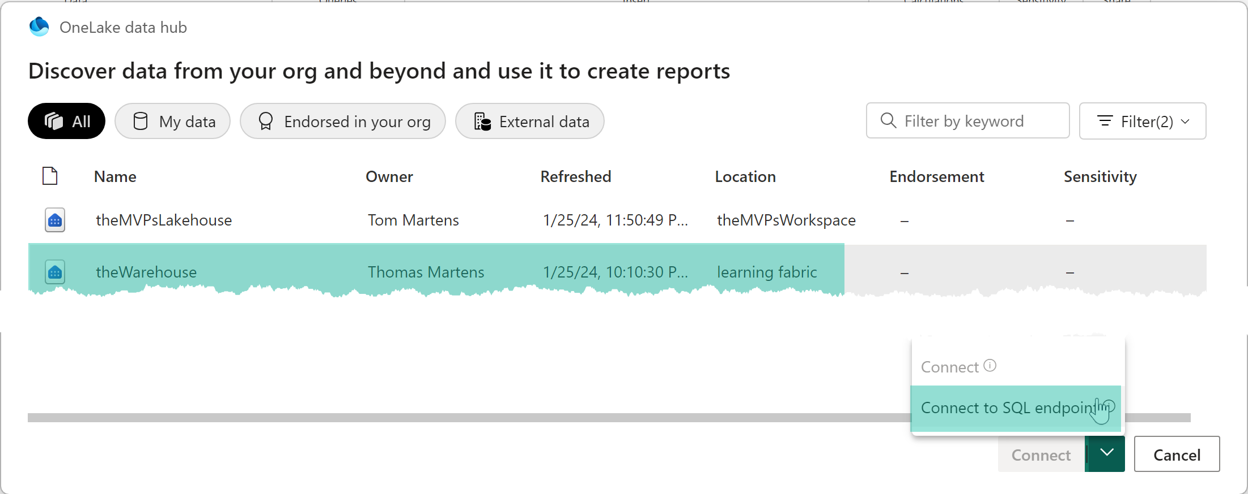
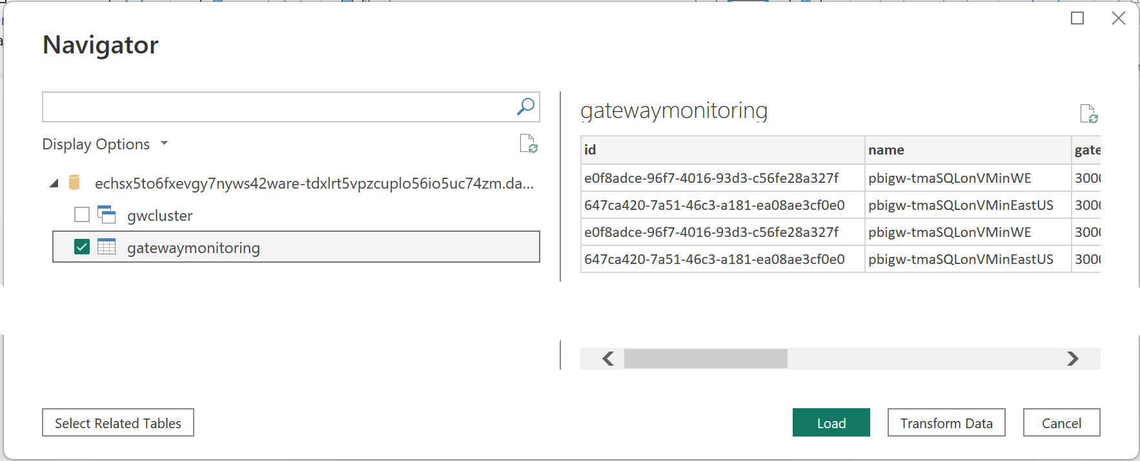
Rstrict Access to objects using T-SQL on the lakehouse (connecting from Power BI)

Slide 24

OneSecurity will change a lot (another game changer)
https://learn.microsoft.com/en-gb/fabric/release-plan/onelake#onesecurity

Slide 25

And now, what?
Get ready for new capabilities!
Understanding core concepts of Microsoft Fabric, like
OneLake, Shortcuts, and the separation of storage and computing are a must, but Azure is not just data!
Do not forget your security requirements 😉

Slide 26
Thank you

